Slide 1
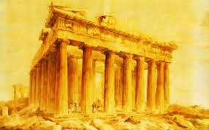
Greek Archaeology
Xuechun Liu, Liwen Zhang, Kailun Huang

Slide 2
Project Background
Client:Natalie Susmann, Archeology Department
PhD Mentor: David Reynolds, Teaching fellow
Dataset: 3 numeric variables(Dependent variables), Others are character variables.
Dependent variables: elevation means, cvso_deg_vis, cvso_visbyarea (topography related characteristics measured for each of 300 Ancient Greek religious structures)
Independent variables: place types
Research Question: Did the ancient Greeks’ use of nature features (i.e., topography) differ across various types of religious structures?

Slide 3
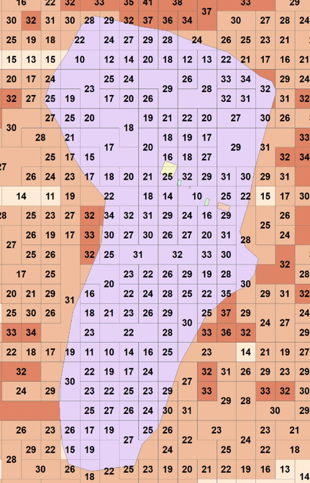
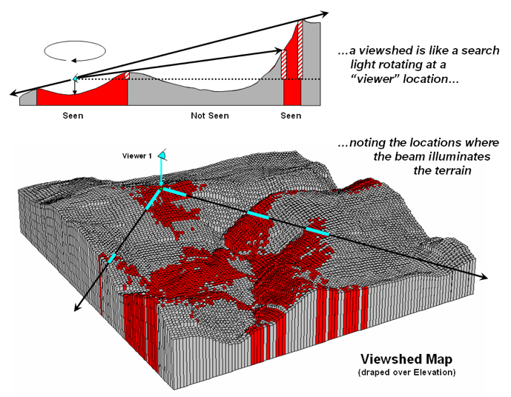

Slide 4
Explanation of the variables
CVSO: Cumulative viewshed of location.
Grid code:The number of times the structure is seen .
CVSO_visbyarea: The total grid code for each structure, divided by the number of pixels which comprises each structure.
CVSO_deg_vis: The total grid code divided by the number of observer points which could possibly see that structure.

Slide 5
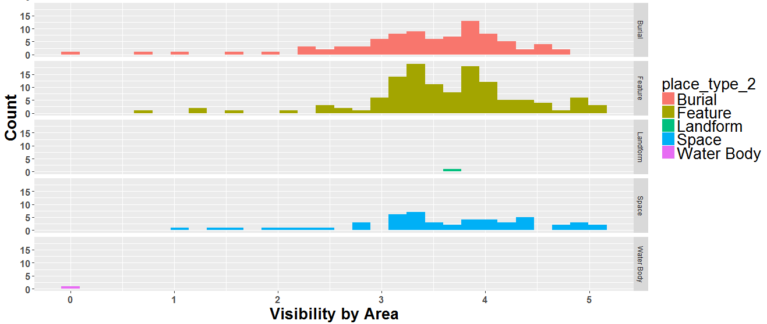
Visibility by possible observer points VS Place Type

Slide 6
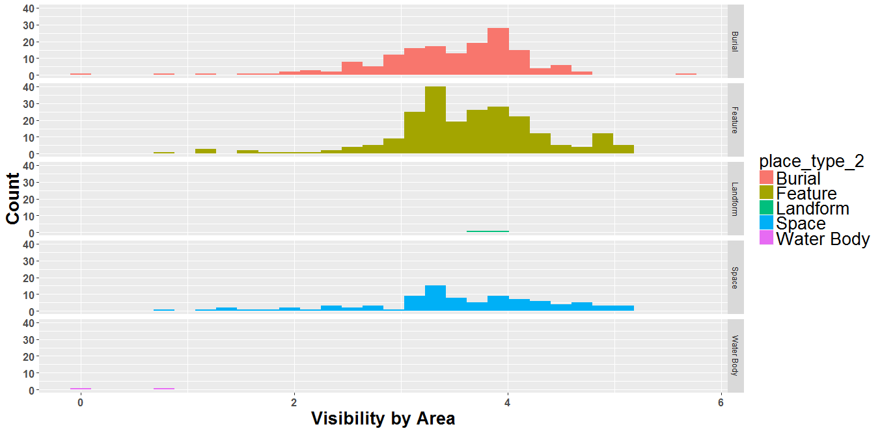
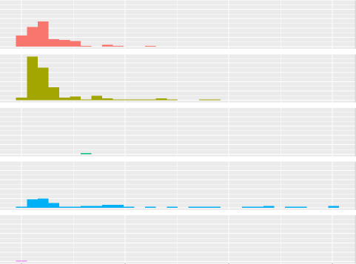
Visibility by area VS Place Type

Slide 7
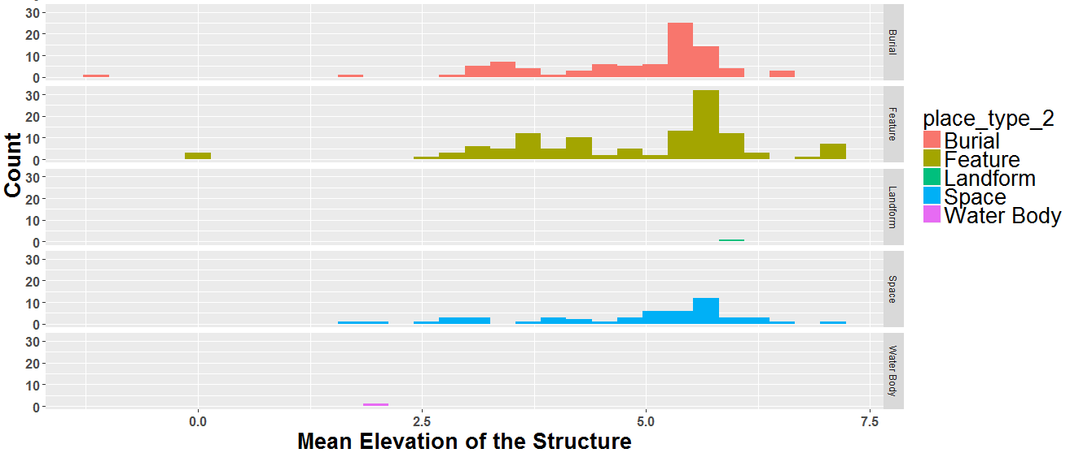
Mean Elevation VS Place Type

Slide 8
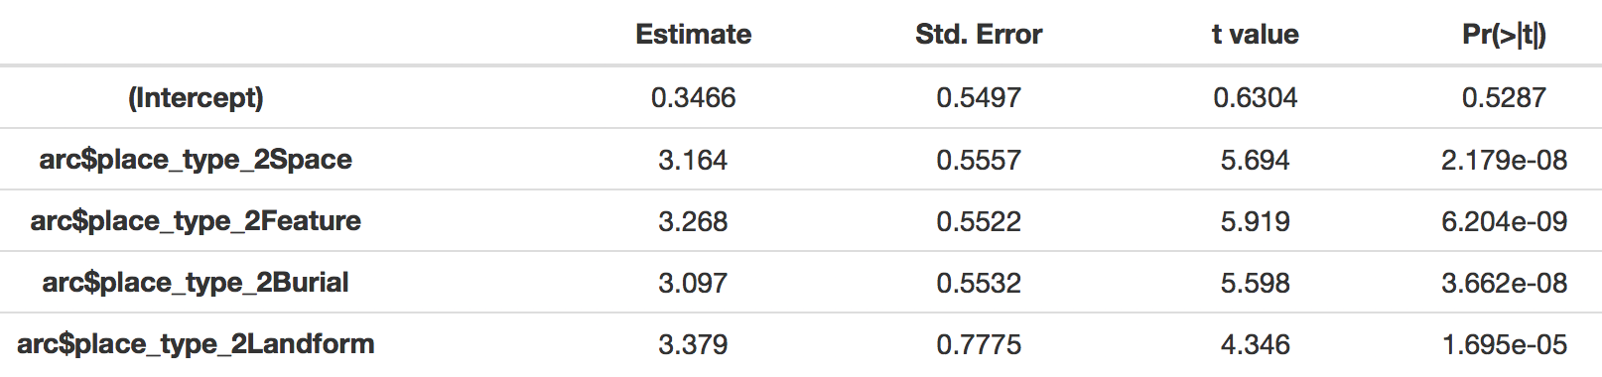
Statistical Analysis
Model 1. lm(log(cvso_visbyarea+1) ~ place_type_2)
Water body (reference level) is significantly different to the other 4 place types at significance level 0.05 in regards to Visibility by area
Notes:
Positive coeff estimate -> smaller visbyarea for water body

Slide 9
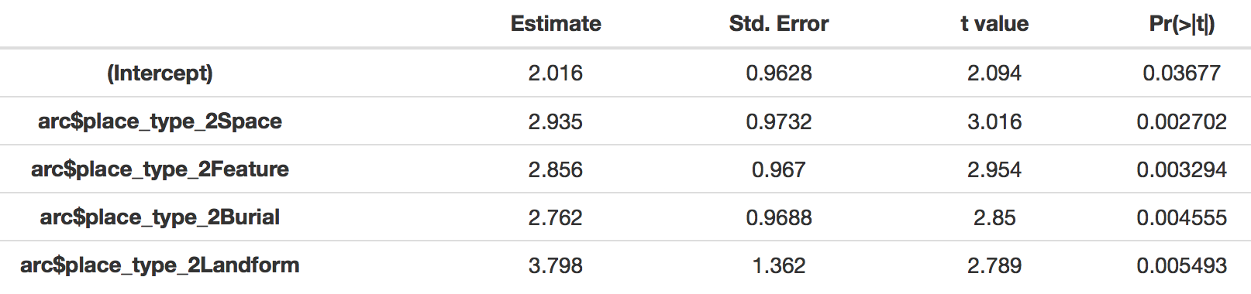
Statistical Analysis
Model 2. lm(log(elevation_mean+1.01) ~ place_type_2)
Water body (reference level) is significantly different to the other 4 place types at significance level 0.05 in regards to mean elevation

Slide 10
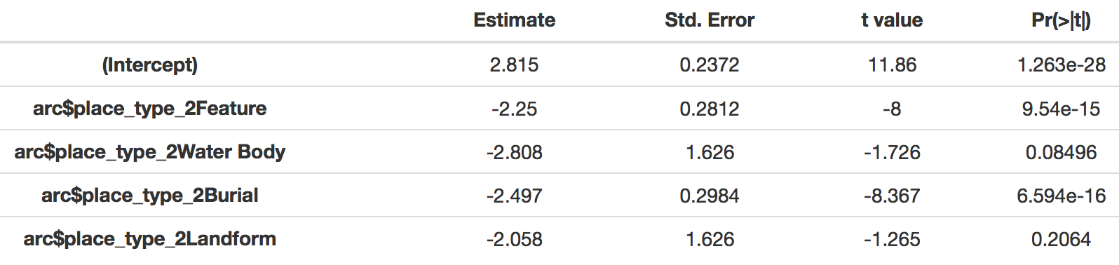
Statistical Analysis
Model 3. lm(cvso_deg_vis ~ place_type_2)
Space (reference level) is significantly different to Feature and Burial at significance level 0.05 in regards to Visibility by possible observer points

